Slide 1
Mobile Computing
Session
GSM
Dr. Navrati Saxena
IMT Ghaziabad

Slide 2
Cellular Concept
Base stations (BS): implement space division multiplex
  Each BS covers a certain transmission area (cell)
  Each BS is allocated a portion of the total number of channels available
  Cluster: group of nearby BSs that together use all available channels
Mobile stations communicate only via the base station, using FDMA, TDMA, CDMA…

Slide 3
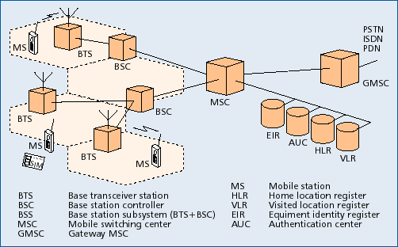
GSM: System Architecture
Notes:
This figure shows the system architecture of a GSM Public Land Mobile Network (PLMN) with its essential components.
A cell is formed by the radio area coverage of a BTS.
One BSC controls several BTS.
The combined traffic of the mobile stations in their respective cells is routed through a switch, the MSC.
Conversations originating from or terminating in a fixed network are handled by GMSC.
Several database are available for call control and network management.

Slide 4
Mobile Station (MS)
MS consists of following two components
    Mobile Equipment (ME)
    Mobile Subscriber Identity Module (SIM)
      Removable plastic card
      Stores Network Specific Data such as list of carrier frequencies and current LAI (Location Area Identifier).
      Stores International Mobile Subscriber Identity (IMSI)
      Stores Personal Identification Number (PIN) & Authentication Keys.
      Also stores short messages, charging information, telephone book etc.
Allows separation of user mobility from equipment mobility
Notes:
MS consists of Mobile Equipment and Mobile Subscriber Identity Module.
GSM distinguishes explicitly between Mobile Subscriber and Mobile Equipment. It deals with them separately.
The subscriber identity is associated within a mobile station by means of a personal chip card, the SIM. SIM is a removable chip.

Slide 5
Base Transceiver Station (BTS)
One per cell
Consists of high speed transmitter and receiver
Function of BTS
  Provides two channels
      Signalling and Data Channel
  Performs error protection coding for the radio channel
Notes:
A BTS is a transmitter - receiver system that serves one cell.
It is controlled by BSC.
A BTS comprises of radio transmission and reception devices, upto and including antenna. A single transreciever within BTS supports eight basic radio channel for the same TDMA frame. BTS is able to handle three to five radio carriers, hence it can support between 24 to 40 simultaneous communications.
Message scheduling has to be made by BTS as it has the exact knowledge of BCCH/CCCH timing (not known by BSC). This includes the paging messages on the paging channel.
Random access detection has to be made by BTS, which in turn send a message to BSC. Subsequent channel assignemnet is made by BSC.
Error protection channel coding/decoding and encryption of the radio channel has to be done in BTS.
Rate adaptation is also done at BTS.
Timing Advance is also determined by the BTS. Uplink radio channel measurement has to be made by BTS.

Slide 6
Base Station Controller (BSC)
Controls multiple BTS
Functions of BSC
  Performs radio resource management
      Assigns and releases frequencies and time slots for all the MSs in its area
      Reallocation of frequencies among cells
      Hand over protocol is executed here
  Time and frequency synchronization signals to BTSs
  Time Delay Measurement and notification of an MS to BTS
  Power Management of BTS and MS
Notes:
BSC is connected to BTS on one side and MSC on the other side.
In order to keep BTS small essential control and protocol intelligence entities resides in the BSC.
It performs Radio Resource Management for all the BTS under its control. It assign and release frequencies and timeslots for all MSs in its area. It does the power management of BTSs and MSs. It provides the time and frequency synchronization reference signals to BTSs. It also measures the time delay of the received MS signal relative to the BTS clock. If the received MS signal is not centered in its assigned timeslot at the BTS, the BSC direct the BTS to notify the MS to advance the timing such that proper synchronization take place.

Slide 7
Mobile Switching Center (MSC)
Switching node of a PLMN (Public Land Mobile Network)
Allocation of radio resource (RR)
  Handover
Mobility of subscribers
  Location registration of subscriber
There can be several MSCs in a PLMN
Notes:
The switching node of a GSM PLMN is the Mobile Switching Center (MSC). The MSC is a telephony switch that performs all the switching functions for MSs located in a geographical area designated as the MSC region.
The MSC performs all the switching functions of a fixed network switching node, eg. Routing path search, signal routing, and service feature processing. The main difference between an ISDN Switch and an MSC is that it has to consider the allocation and administration of radio resources and the mobility of the subscribers also. The MSC therefore has to provide additional functions for location registration of subscribers and for the handover of a connection in case of changing cell to cell. A PLMN can have several MSCs with each being responsible for a part of the Service Area.
The MSC must also handle different types of number and identities related to the same MS contained in different registers. IMSI, TMSI, ISDN number, MSRN etc. In general, identities are used in the interfaces between the MSC and the MS, while numbers are used in the fixed part of the Network, such as, for routing.

Slide 8
Gateway MSC (GMSC)
Connects mobile network to a fixed network
  Entry point to a PLMN
Usually one per PLMN
Request routing information from the HLR and routes the connection to the local MSC
Notes:
Dedicated Gateway MSCs (GMSCs) are available to pass voice traffic between fixed networks and mobile network.
GMSC queries the database (HLR ) and routes the connection to the local MSC in whose area the mobile station is currently staying.

Slide 9
HLR/VLR
HLR - Home Location Register
  For all users registered with the network, HLR keeps user profile
  MSCs exchange information with HLR
  When MS registers with a new GMSC, the HLR sends the user profile to the new MSC
VLR - Visitor Location Register
  VLR is responsible for a group of location areas, typically associated with an MSC

Slide 10
AuC/EIR/OSS
AuC: Authentication Center
  is accessed by HLR to authenticate a user for service
  Contains authentication and encryption keys for subscribers
EIR: Equipment Identity Register
  allows stolen or fraudulent mobile stations to be identified
Operation subsystem (OSS):
  Operations and maintenance center (OMC), network management center (NMC), and administration center (ADC) work together to monitor, control, maintain, and manage the network

Slide 11
Number of channels in GSM
Freq. Carrier: 200 kHz
TDMA: 8 time slots per freq carrier
No. of carriers = 25 MHz / 200 kHz = 125
Max no. of user channels = 125 * 8 = 1000
Considering guard bands = 124 * 8 = 992 channels

Slide 12
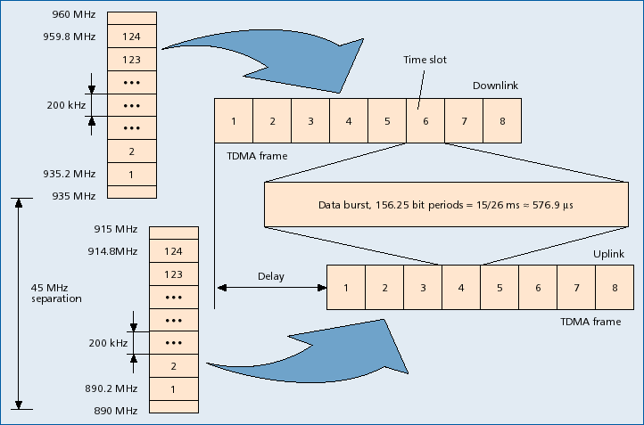
GSM multiple access

Slide 13
Traffic Channel
Transfer either encoded speech or user data
Bi-directional
Full Rate TCH
  Rate 22.4kbps
Half Rate TCH
  Rate 11.2 kbps

Slide 14

GSM Speech Coding
104 kbps
13 kbps
Analog
speech
Low-pass
filter
A/D
RPE-LTP
speech
encoder
Channel
encoder
8000 samples/s,
13 bits/sample

Slide 15
GSM: System Architecture
Notes:
This figure shows the system architecture of a GSM Public Land Mobile Network (PLMN) with its essential components.
A cell is formed by the radio area coverage of a BTS.
One BSC controls several BTS.
The combined traffic of the mobile stations in their respective cells is routed through a switch, the MSC.
Conversations originating from or terminating in a fixed network are handled by GMSC.
Several database are available for call control and network management.

Slide 16
Outgoing call setup
  User keys in the number and presses send
  Mobile transmits request on uplink signaling channel
  If network can process the call, BS sends a channel allocation message
  Network proceeds to setup the connection
Network activity:
  MSC determines current location of target mobile using HLR, VLR and by communicating with other MSCs
  Source MSC initiates a call setup message to MSC covering target area

Slide 17
Incoming call setup
  Target MSC initiates a paging message
  BSs forward the paging message on downlink channel in coverage area
  If mobile is on (monitoring the signaling channel), it responds to BS
  BS sends a channel allocation message and informs MSC
Network activity:
  Network completes the two halves of the connection

